Slide 1

NETWORK NODE DISCOVERY USING
SWITCH CAM
CMR INSTITUTE OF TECHNOLOGY
Guide,
Ms. Sagarika Behera,
Assistant Professor,
CMRIT
Department of Computer Science and Engineering
By,
Deepika Vasudevan 1CR11CS129
Sushma R 1CR11CS104
Tejaswini BS 1CR11CS108
Vidya Sri M 1CR11CS118

Slide 2
AGENDA
INTRODUCTION
Abstract
Literature Survey
Existing System
PROPOSED SYSTEM
Functional Requirements
Non-functional Requirements
Software Architecture
Hardware Architecture
SYSTEM DESIGN
Data Flow Diagram
Activity Diagram

Slide 3
AGENDA
SYSTEM DESIGN
Use Case Diagram
Sequence Diagram
State Diagram
Class Diagram
ER Diagram
TESTING
Types of Testing
Test Results
RESULTS
Database Access
Website

Slide 4
INTRODUCTION

Slide 5
ABSTRACT
A Local Area Network would normally consist of network switches which are remotely manageable.
As the number of network nodes increases, the complexity of monitoring, maintaining and troubleshooting also increases.
In order to find nodes that have an error, locating the switch port to which a node is connected is necessary.
The proposed system maps the Switch Port of the all nodes and finds the status information of each node.

Slide 6
LITERATURE SURVEY
1
4
3
Li Zichao, Hu Ziwei, Zhang Geng, Ma Yan, Ethernet Topology Discovery for Virtual Local Area Networks with Incomplete Information, September 2014
2
Cisco, SNMP Community String Indexing
Cisco, How to Get Dynamic CAM Entries (CAM Table) for Catalyst Switches Using SNMP
Suman Pandey, Mi-Jung Choi, Sung-Joo Lee, James W. Hong, IP Network Topology Discovery using SNMP, May 2011

Slide 7
EXISTING SYSTEMS
Research Ventures
Commercial Ventures
Combing ping, traceroute, DNS and ARP
ICMP Spoofing
Efforts made by CISCO to standardize Physical Network Topology Identification
HP OpenView, IBM’s Tivoli and AdventNet, OpManager

Slide 8
PROPOSED
SYSTEM

Slide 9
FUNCTIONAL REQUIREMENTS
Authentication of the user by the system.
Initialize first polling when user successfully logs into system.
Efficient polling is completed by the manager.
Identify the nodes present and collect data associated with it.
Consolidated information stored into the database.
Display required information when MAC address of the node is entered.

Slide 10
NON-FUNCTIONAL REQUIREMENTS
Product
Requirements
External
Requirements
Organisational
Requirements
Usability
Performance
Space
Portability
Privacy
Implementation

Slide 11
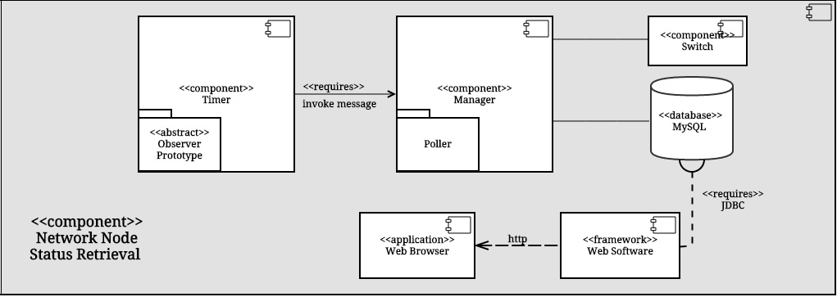
SOFTWARE ARCHITECTURE

Slide 12
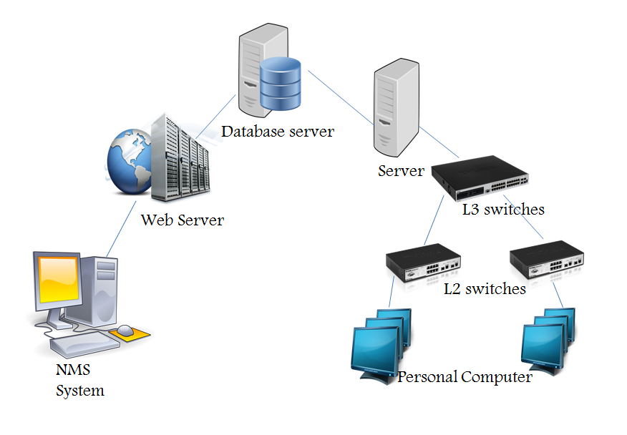
HARDWARE ARCHITECTURE

Slide 13
SYSTEM
DESIGN

Slide 14
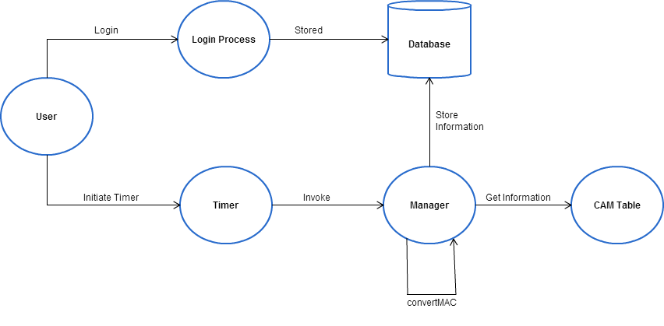
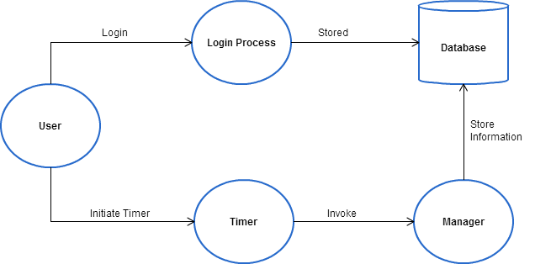
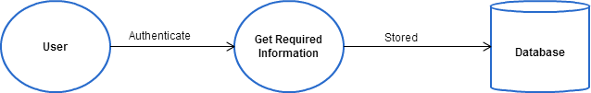
DATA FLOW DIAGRAM

Slide 15
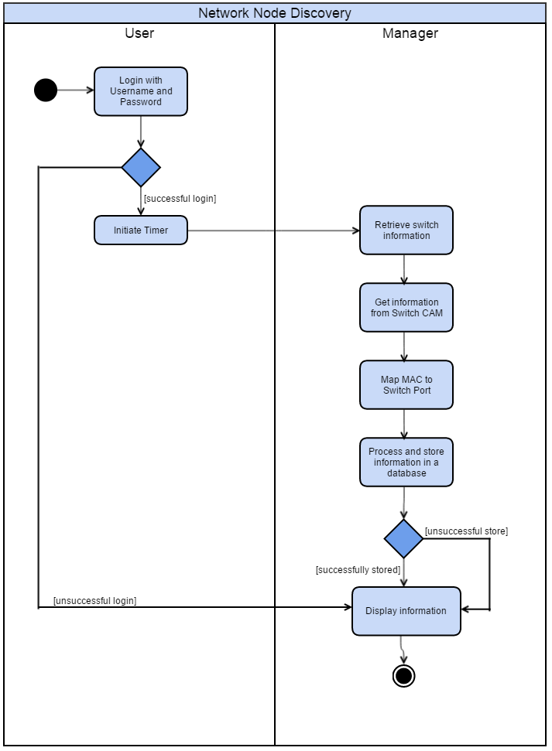
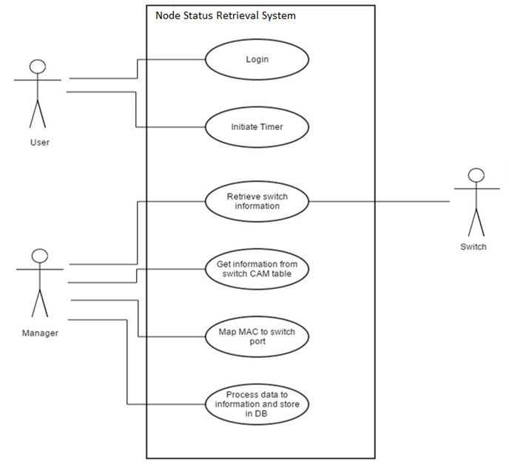
ACTIVITY DIAGRAM
USE CASE DIAGRAM

Slide 16
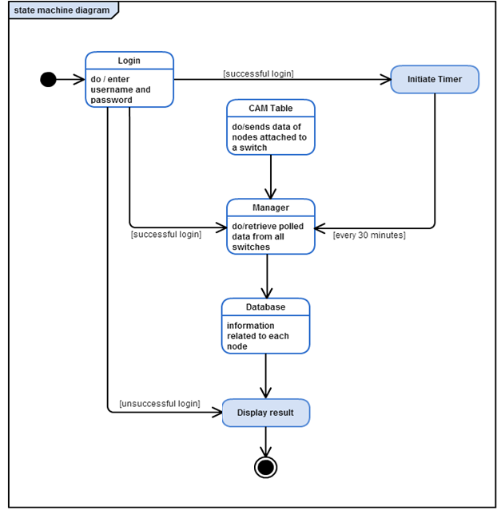
STATE
DIAGRAM

Slide 17
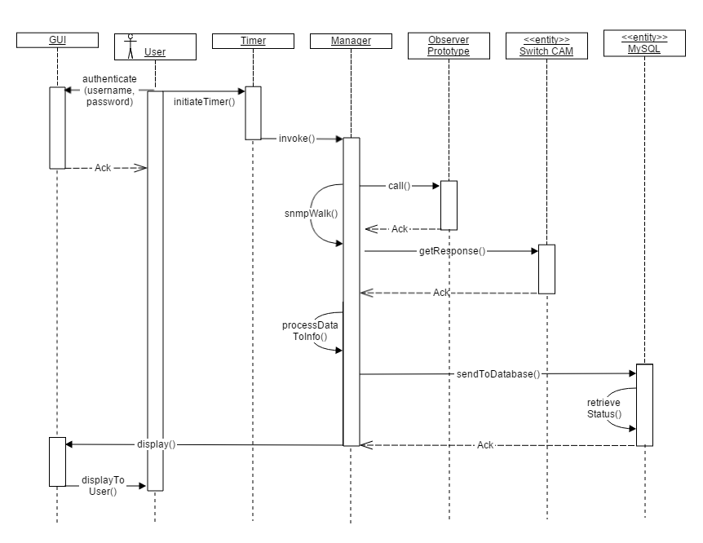
SEQUENCE DIAGRAM

Slide 18
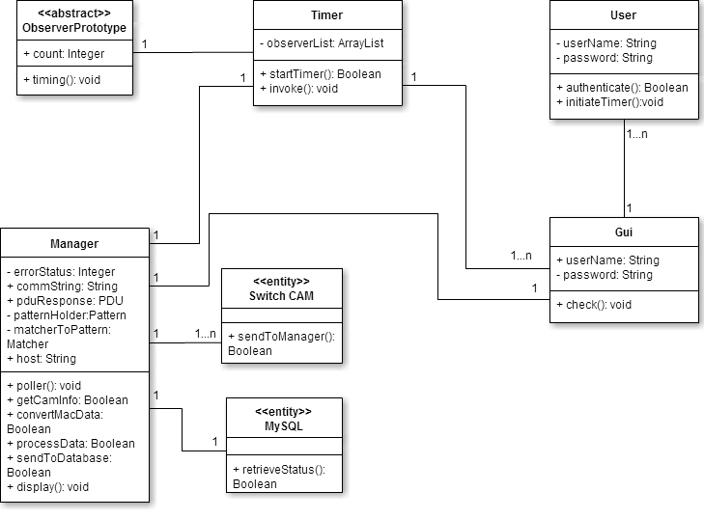
CLASS DIAGRAM

Slide 19
TESTING

Slide 20
TESTING
Functional
Testing
Regression
Acceptance
Alpha and Beta
Types of Testing
Functional
Non-functional
Non-Funtional
Testing
Performance
Usability
Security

Slide 21
UNIT TEST CASES
Sl. No | Case Description | Input | Pass/Fail | Comments
1 | Select Home Page | User Type implicitly taken from database | Pass | Admin/User success page reached
2 | Navigation | User click on links | Pass | Working Fine
3 | Display | Check Display format | Pass | Working Fine
4 | Search Contents | Give MAC/Switch Details | Pass | Results displayed fine
5 | Initialize Database | Implicit: Timeout | Pass | Database entries initialised to inactive
6 | Resize Screen | Minimize/Maximize | Fail | Layout changed

Slide 22
INTEGRATION TEST CASES
Sl. No | Case Description | Input | Pass/Fail | Comments
1 | Timer Begin | Implicit: Successful Login | Pass | Timer Starts
 |  | 30mins after successful Login | Pass | Timeout Notification sent
2 | Poll | Specific OID | Pass | Successful Community String Indexing
 |  | Trigger: Timeout | Pass | Polling
3 | Data Transformation | OID raw Data | Pass | Regular Expression used before database population
4 | Update Database | Trigger: Timeout | Pass | Update table entries to active
6 | Poll Output | Request entry while polling | Fail | Previous Value used
7 | Logout | Clicks Logout | Pass | Working Fine
 |  | Back Redirection | Fail | Previous Page reached

Slide 23
SYSTEM TEST CASES
Sl. No | Case Description | Input | Pass/Fail | Comments
1 | User Login | Valid username and valid password | Pass | Successful Login
 |  | Invalid username and invalid password | Pass | Error: Invalid Entries
 |  | Only username | Pass | Error requesting password
 |  | Only password | Pass | Error requesting username
 |  | Invalid username and valid password | Pass | Error: Invalid Entries
 |  | Valid username and invalid password | Pass | Error: Invalid Entries
 |  | Login redirection entered as URL | Fail | Success page reached when URL entered directly
 |  | Valid MAC Address | Pass | Working Fine
 |  | Invalid MAC Address | Pass | Error Message
 |  | Valid VLAN No. | Pass | Working Fine
2 | Search Entries | Invalid VLAN No. | Pass | Error Message
 |  | Valid Switch ID | Pass | Working Fine
 |  | Invalid Switch ID | Pass | Error Message
 |  | Valid Port No. | Pass | Working Fine
 |  | Invalid Port No. | Pass | Error Message

Slide 24
SYSTEM TEST CASES
3 | Page Refresh | Renter Search entry(Without refresh) | Fail | Needs Improvement
 |  | Renter Search entry(With refresh) | Pass | Refreshed Page
4 | Add User(Admin) | New username and password | Pass | Working Fine
5 | Change Password | Current and New Password | Pass | Working Fine
6 | Maximum Entries while Database Update | Population of data | Fail | Not Tested
7 | Page Refresh | Renter Search entry(Without refresh) | Fail | Needs Improvement
 |  | Renter Search entry(With refresh) | Pass | Refreshed Page

Slide 25
RESULTS

Slide 26
DATABASE ACCESS

Slide 27
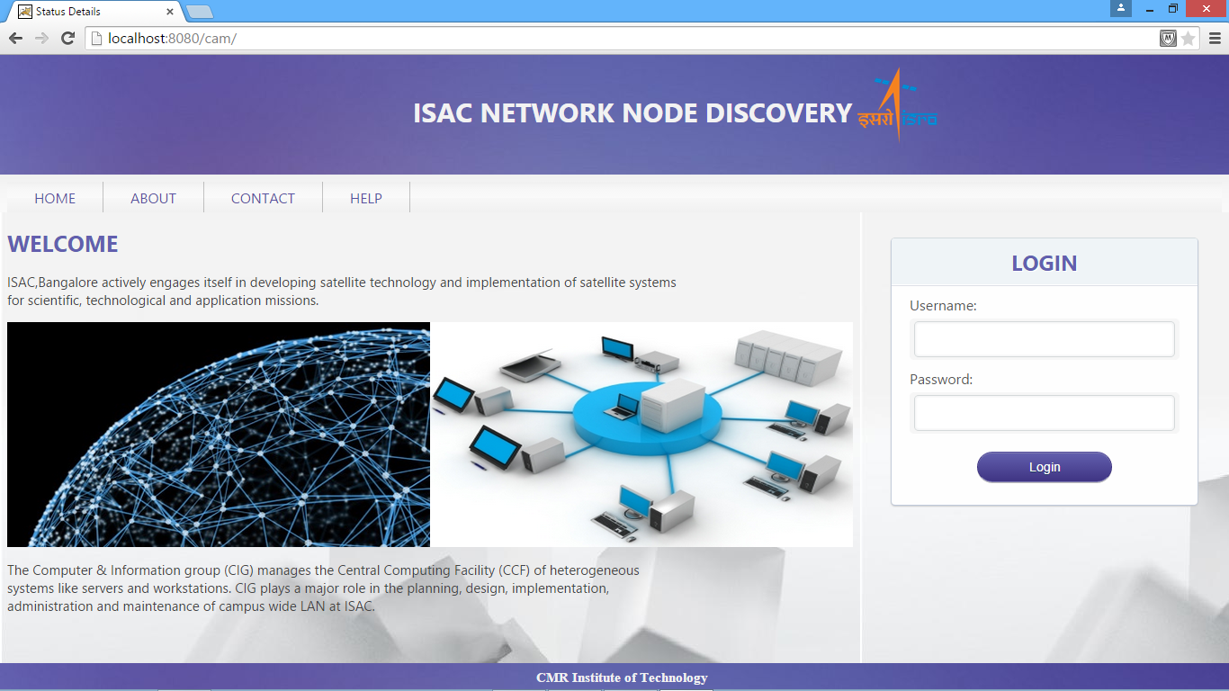
RESULTS

Slide 28
THANK YOU!

